Slide 1
Punk IPA API Filter
Plan:
Create react file in bash
add react file to repo
clone repo
import data (refrence fetch lessons)
create structure - similar to ticket tracket or pokedom
Import structure from ticket tracker and pokedom

Slide 2
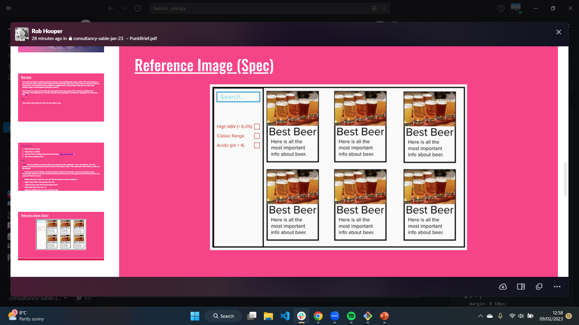
Red: App-container
Purple: cardContainer-container
yellow: car-component
Green: navBar-container
Blue: search-component
Mustard: filterButtonContainer-container
Pink: filterButton
Initial Filters:
High Alcohol (ABV value greater than 6%)
Classic Range (Was first brewed before 2010)
High Acidity (pH lower than 4)

Slide 3
Primary Objective: Create a file template using react of webpage without functions
Secondary Objective: Format webpage with card using data file without functions.
New goals:
Large data file with pagination and searching whole array. Obtained from reading the api documentation
Overlay each card with all information (similar to the beatles)
Learn useeffect

Slide 4
Create container for buttons for page selection – need to work on edge cases
Create dropdown for results per page - complete
Create overlay for cards on hover – css practice
Create page overlay for cards on click – css pratice
Create button for opening page with beer breakdown. – routing practice
Slider for filters rather than checkboxes
Inline deconstruct props for cleaner code

Slide 5
Done
Card changes on hover
Overlay appears on clicking card
16:14 13/02/23
Done:
All linking and basic files are complete
To Do:
Format all information on containers to be informative.
To Do:
Create a landing place for beer information
Create a Nav-Bar/home Button to navigate back to original page
Format all information on containers to be informative.
Use routes to guide to relevant landing places

Slide 6
To Do:
Format Card- Container
Format Hover Overlay
Format Click Overlay
Format Beer Page
Format Nav-Bar
Format WebPage
Add Proper Home Button

Slide 7
PageName
Name search
Filter boxes
Card container
<
Page Num / totalpages
<
card
card
card
card
card
card
card
card
card
card
<
Page Num / totalpages
<

Slide 8
Beer dedicated route
"name": "Jinx Pale Ale",
"tagline": "American Pale Ale.",
"first_brewed": "2018",
"description": "A new 4.7% ABV American pale ale, Jinx Pale Ale is one of the core Fanzine beers, and will feature evolving editions as part of our new subscription model.",
"image_url": null,
"abv": 4.7,
"ph": 4.6,
Ingredients – to be formated
"food_pairing": [
"Monterey Jack stuffed grilled jalapeños",
"Apple pie"
],
"ibu": 32,
"ebc": 11,
"srm": 10,
Overlay with explanations of acronyms.
"ingredients": {
"malt": [
{
"name": "Pale Ale",
"amount": {
"value": 3.12,
"unit": "kilograms"
}
},
{
"name": "Munich",
"amount": {
"value": 0.48,
"unit": "kilograms"
}
},
{
"name": "Dextrin Malt",
"amount": {
"value": 0.18,
"unit": "kilograms"
}
}
],
"hops": [
{
"name": "Simcoe",
"amount": {
"value": 6,
"unit": "grams"
},
"add": "65",
"attribute": "Bittering"
},
{
"name": "Chinook",
"amount": {
"value": 10,
"unit": "grams"
},
"add": "10",
"attribute": "Flavour"
},
{
"name": "Simcoe",
"amount": {
"value": 20,
"unit": "grams"
},
"add": "0",
"attribute": "Aroma"
},
{
"name": "Chinook",
"amount": {
"value": 20,
"unit": "grams"
},
"add": "0",
"attribute": "Aroma"
},
{
"name": "Simcoe",
"amount": {
"value": 60,
"unit": "grams"
},
"add": "Dry Hop",
"attribute": "Aroma"
},
{
"name": "Centennial",
"amount": {
"value": 60,
"unit": "grams"
},
"add": "Dry Hop",
"attribute": "Aroma"
}
],
"yeast": "Wyeast 1056 - American Ale™"
},

Slide 9
On mobile yellow boxes restructure to vertical
All Beers
img
img
Standard Reference Method (Srm) is the method for color assessment of wort or beer as published in the recommended methods of the American Society of Brewing Chemists.
EBC stands for European Brewery Convention and it's used as a measure of colour intensity.
https://redlionkegworth.co.uk/wp-content/uploads/2019/11/Standard-Reference-Method-for-Beer-Colour-2019-Red-Lion-Kegworth-1.png
IBU stands for “International Bitterness Unit”. is a measurement of the bitterness of a beer
https://abita.com/images/uploads/chart_color_bitterness.jpg
x
name
Brew Year tagline
Abv | pH
ibu | ebc | srm
?
Description
Food pairings
desc
img
Ingredients
desc
img

Slide 10
Beer container page overlay
"name": "Jinx Pale Ale",
"abv": 4.7,
"first_brewed": "2018",
"description": "A new 4.7% ABV American pale ale, Jinx Pale Ale is one of the core Fanzine beers, and will feature evolving editions as part of our new subscription model.",
"image_url": null,
"food_pairing": [
"Monterey Jack stuffed grilled jalapeños",
"Apple pie"
],
"ph": 4.6,
img
X
name
Abv | pH
Descrip – less abbreviated…
Food pairings
Full Details

Slide 11
On mobile clicking page links to full website as hoverover doesn’t exist
beer card
Beer card hover overlay
"name": "Jinx Pale Ale",
"tagline": "American Pale Ale.“
"image_url": null, large
"abv": 4.7,
img
"name": "Jinx Pale Ale",
"tagline": "American Pale Ale.“
"description": "A new 4.7% ABV American pale ale, Jinx Pale Ale is one of the core Fanzine beers, and will feature evolving editions as part of our new subscription model.",
"image_url": null,
"abv": 4.7,
Quick preview | Full Details
img
name
tagline
name
Descrip –abbreviated…
tagline
abv
abv
Quick preview | Full Details

